Slide 1
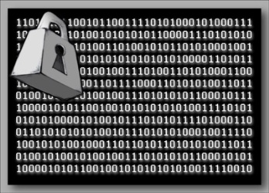
Introduction to Cryptography
Notes:
https://en.wikipedia.org/wiki/Authenticated_encryption
https://unicode-table.com/en/

Slide 2
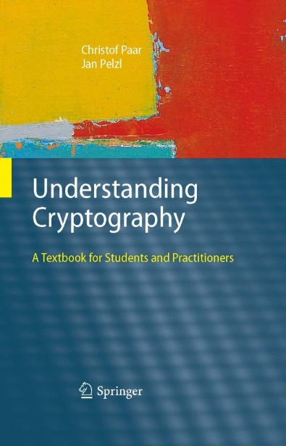
Acknowledgement
These slides are based on the following resources (but modified):
Slides accompanying the textbook ‘Understanding Cryptography’ by
Christof Paar and Jan Pelzl
http://crypto-textbook.com/
Slides from Dr. Ryan Riley
https://vsecurity.info/

Slide 3
Outline
Introduction to Cryptography
Caesar Cipher
Substitution Cipher
One-Time Pad Cipher
Notes:
Overview on the field of cryptology
Basics of symmetric cryptography
Cryptanalysis

Slide 4
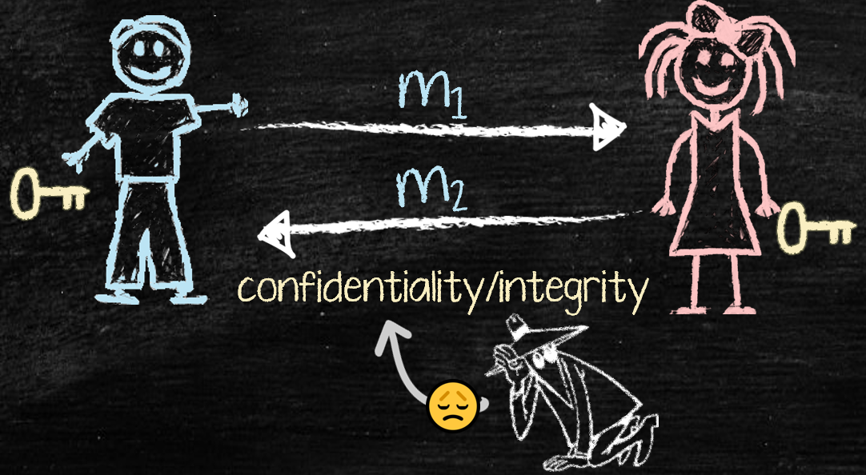
Introduction to Cryptography

Slide 5
Definition
The word Cryptography is Greek
Crypto: Secret + Graphy: Writing
Method to send secret messages using a key
Basic goal is Secure communication
Send messages that no one but the expected recipient can read
Many other applications such as:
Cryptocurrency, Blockchains
Authentication
Digital signatures
…
Notes:
Has so many other applications, though!
Message sent via unsecure channel (e.g. Internet)
A malicious third party has channel access but should not be able to understand the exchanged messages
Secure communication
Unsecure
channel
(e.g. Internet)

Slide 6
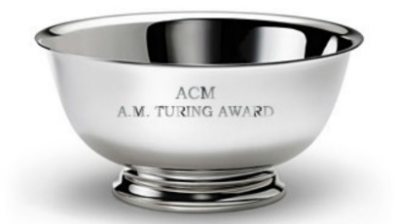
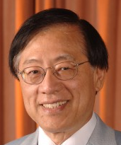
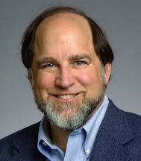
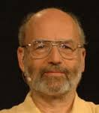
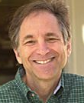
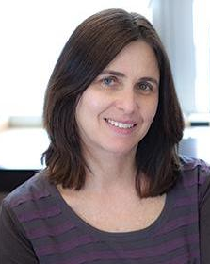
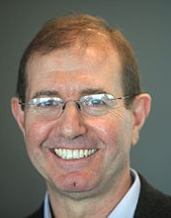
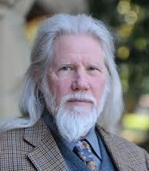
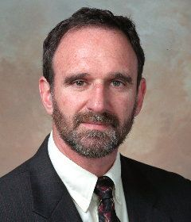
Is Crypto important?
[Fact - wiki] Today, cryptography has become ubiquitous with the development of the Internet.
[Academia] Over 20 years, cryptographers won Turing Award (CS Nobel Prize) four times
2000
2002
2012
2015

Slide 7
Terminology
Plaintext: A message in its original form
Ciphertext: A message in encrypted form
Encryption: Transforming PT to CT
Decryption: Transforming CT to PT
Encryption Algorithm / Cipher: The method used for encryption

Slide 8


Symmetric Cryptography
Alternative names: private-key, single-key or secret-key cryptography.
Eve (bad guy)
Unsecure channel (e.g. Internet)
Alice
P
P
Bob
Problem Statement: 1) Alice and Bob would like to communicate via an unsecure channel (e.g., Internet) 2) A malicious third party Eve (the bad guy) has channel access but should not be able to understand the exchanges messages
8

Slide 9
Symmetric Cryptography
Solution: Encryption with symmetric cipher. ⇒ Eve obtains only ciphertext C, that looks like random bits
Eve (bad guy)
Unsecure channel (e.g. Internet)
C
Alice
Encryption e( )
Decryption d( )
Bob
P
C
P
K
K
P is the. plaintext
C is the ciphertext
K is the key
Set of all keys {K₁, K₂, ...,K_{n}} is the key space
Secure Channel
9
Notes:
Key Generator

Slide 10
Symmetric Cryptography
Encryption equation C = e_{K}(P)
Decryption equation P = d_{K}(C)
Encryption and decryption are inverse operations if the same key K is used on both sides:
d_{K}(C) = d_{K}(e_{K}(P)) = P
Important: The key must be transmitted via a secure channel between Alice and Bob.
The secure channel can be realized, e.g., by a human courier or a secure key exchange mechanism (this will be covered later)
However, the system is only secure if an attacker does not learn the key K!
⇒ The problem of secure communication is reduced to secure transmission and storage of the key K
10
Notes:
by manually installing the key for the Wi-Fi Protected Access (WPA) protocol

Slide 11
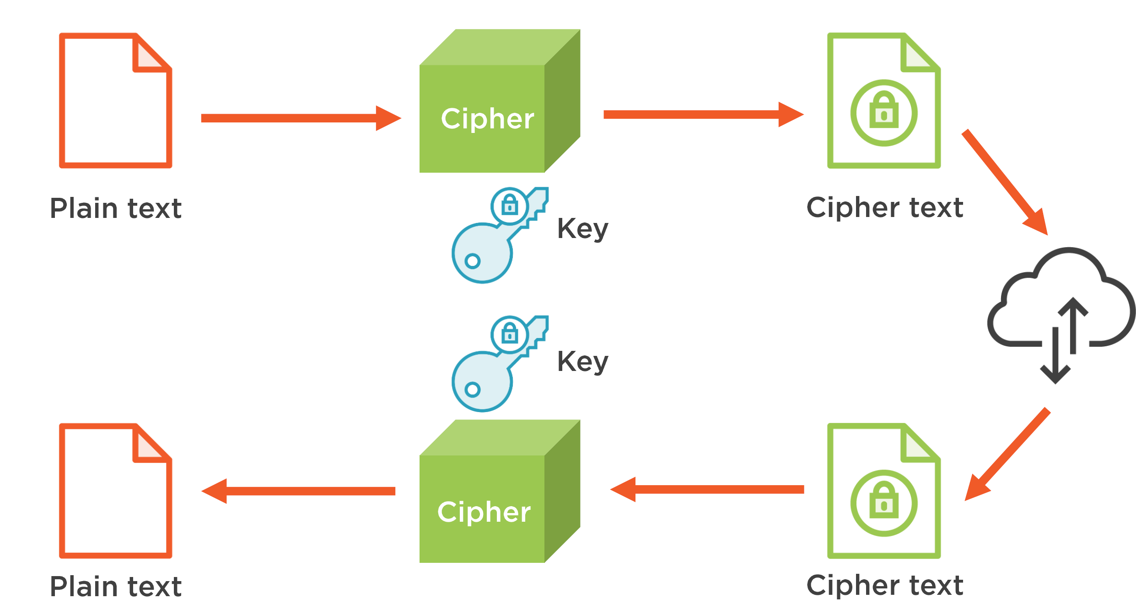
Symmetric Cryptography - Summary

Slide 12
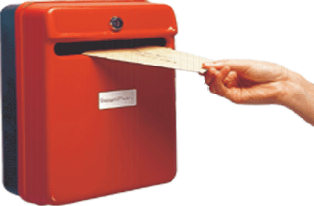

Idea behind Asymmetric Cryptography
New Idea:
Use the „good old mailbox“ principle:
Everyone can drop a letter
But: Only the owner has the correct key to open the box
1976: first publication of such an algorithm by Whitfield Diffie and Martin Hellman,and also by Ralph Merkle.

Slide 13
Asymmetric (Public-Key) Cryptography
Principle: “Split up” the key
K
Public Key (K_{pub}) (Encrypt)
Secret Key (K_{pr}) (Decrypt)
� During the key generation, a key pair K_{pub} and K_{pr} is computed

Slide 14
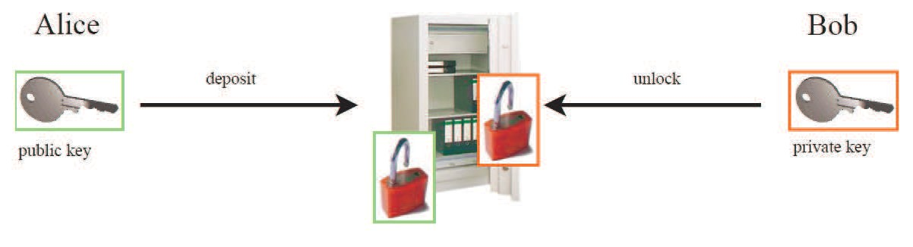
Asymmetric Cryptography: Analogy
Safe with public lock and private lock:
(K_{pub})
(K_{pr})
Alice deposits (encrypts) a message with the - not secret - public key K_{pub}
Only Bob has the - secret - private key K_{pr} to retrieve (decrypt) the message

Slide 15
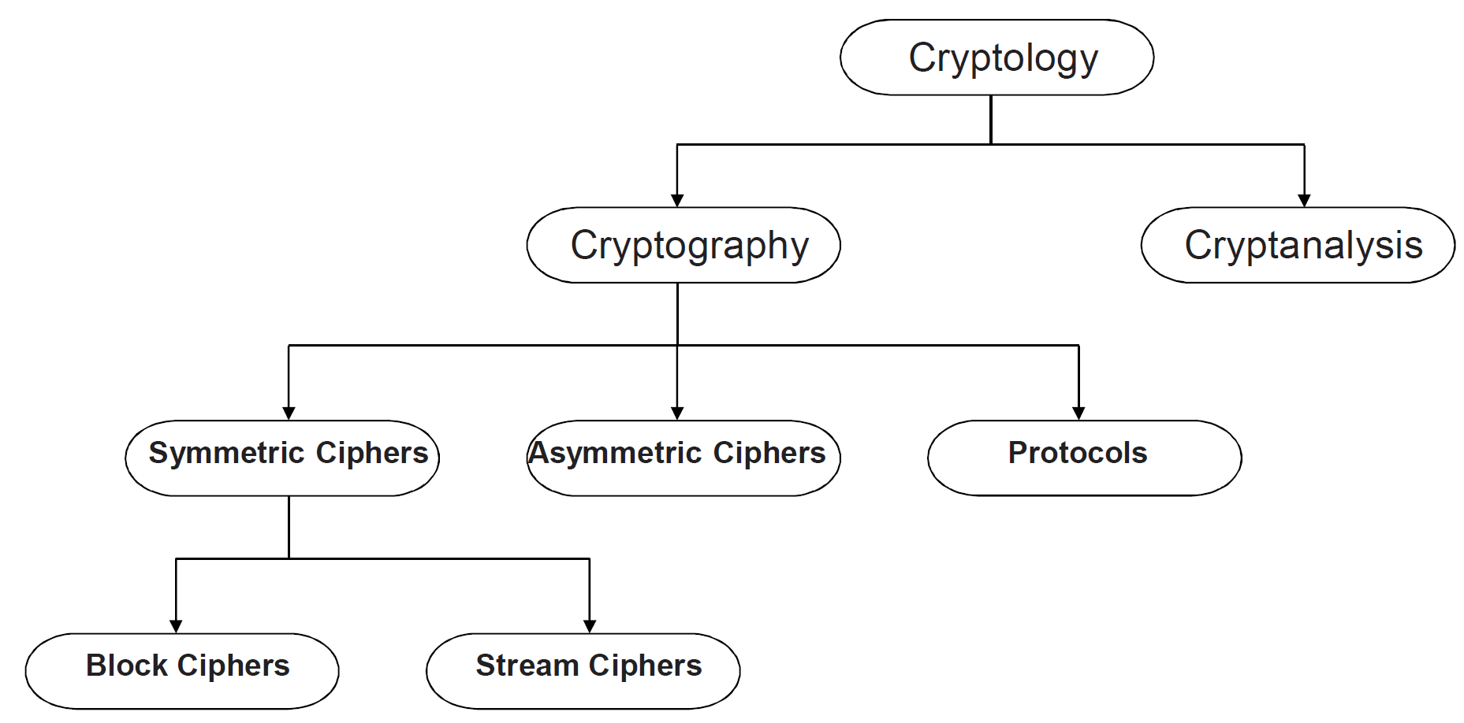
Classification of the Field of Cryptology
Cryptanalysis = Trying to break the key and read enrypted messages
Chapter 1 of Understanding Cryptography by Christof Paar and Jan Pelzl

Slide 16
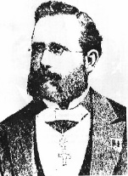
Why do we need Cryptanalysis?
There is no mathematical proof of security for any practial cipher
The only way to have assurance that a cipher is secure is to try to break it (and fail) !
We let lots of really smart people try to break it (cryptanalysis). If they can’t, we assume it is secure
But… We might be wrong
Kerckhoff Principle is paramount in modern cryptography:
A cryptosystem should be secure even if the attacker knows all details about the system, with the exception of the secret key
In order to achieve Kerckhoff‘s Principle in practice: Only use widely known ciphers that have been cryptanalyzed for several years by good cryptographers!
Remark: It is tempting to assume that a cipher is “more secure“ if its details are kept secret. However, history has shown time and again that secret ciphers can almost always been broken once they have been reversed engineered. (Example: Content Scrambling System (CSS) for DVD content protection.)
16
Notes:
(Understanding Cryptography only treats such ciphers)
There is no mathematical proof of security for any practical cipher
The only way to have assurance that a cipher is secure is to try to break it (and fail) !
Classical Attacks
Mathematical Analysis
Brute-Force Attack
Implementation Attack: Try to extract key through reverese engineering or power measurement, e.g., for a banking smart card.
Social Engineering: E.g., trick a user into giving up her password

Slide 17

Kerckhoff’s Principle
Security of a Cryptographic Algorithm should rely
ONLY on the secrecy of the KEYS, and
NOT on the secrecy of the METHOD used
“Do not rely on security through obscurity”
Notes:
Lesson 2: algorithm is public, key is secret!

Slide 18
Brute-Force Attack (or Exhaustive Key Search) against Symmetric Ciphers
Treats the cipher as a black box
Requires (at least) 1 plaintext-ciphertext pair (P₀, C₀)
Check all possible keys until condition is fulfilled:
d_{k}(C₀) = P₀
Key length in bit | Key space | Security life time
64 | 2⁶⁴ | Short term (few days or less)
128 | 2¹²⁸ | Long-term (several decades in the absence of quantum computers)
256 | 2²⁵⁶ | Long-term (also resistant against quantum computers – note that QC do not exist at the moment)
Notes:
(assuming brute-force as best possible attack)
and might never exist
Important: An adversary only needs to succeed with one attack. Thus, a long key space does not help if other attacks (e.g., social engineering) are possible..

Slide 19
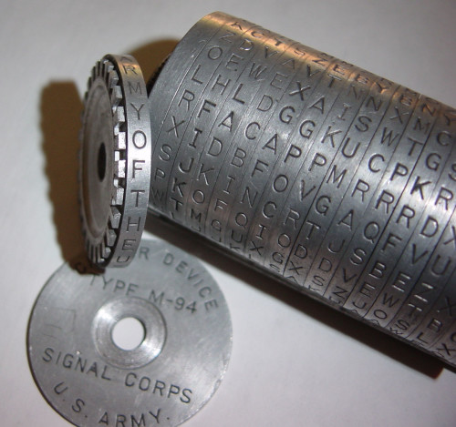
Caesar Cipher

Slide 20
Simple Ciphers
Originally, cryptography was performed by hand
Goal was to protect messages sent by couriers
From people who might intercept the courier
From the courier himself
War was a popular time to use them

Slide 21
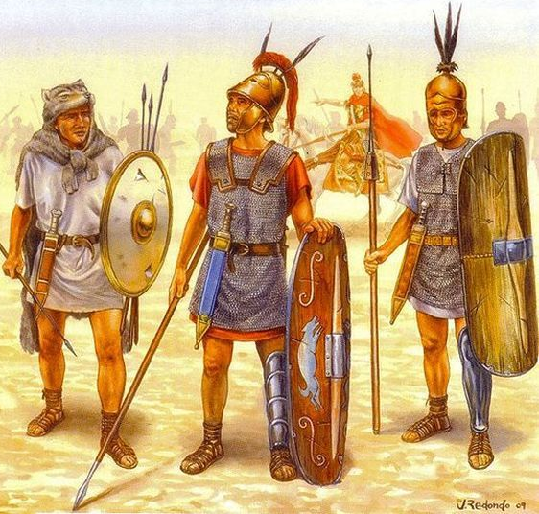
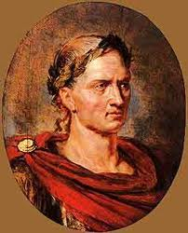

Caesar Cipher
Julius Ceasar (100-44 BC)
DWWDFN DW GDZQ
ATTACK AT DAWN
ATTACK AT DAWN
Encrypt the message!
Decrypt the ciphertext!
The sender and receiver must know something that the adversary doesn’t.
This is called a cryptographic key
21
Notes:
Greeks were also the originators of cryptography. Cryptography – kryptos (secret) + graphein (writing) – means secret writing.

Slide 22
Caesar Cipher
Secret key: A random number from {1,…,26}, say 3
DWWDFN DW GDZQ
Encryption
Message:
ATTACK AT DAWN
↓↓↓↓↓↓ ↓↓ ↓↓↓↓
DWWDFN DW GDZQ
Key: + 3
Ciphertext:

Slide 23
Caesar Cipher
Secret key: A random number from {1,…,26}, say 3
DWWDFN DW GDZQ
Decryption
Ciphertext:
DWWDFN DW GDZQ
Key: - 3
Message:
↓↓↓↓↓↓ ↓↓ ↓↓↓↓
ATTACK AT DAWN

Slide 24
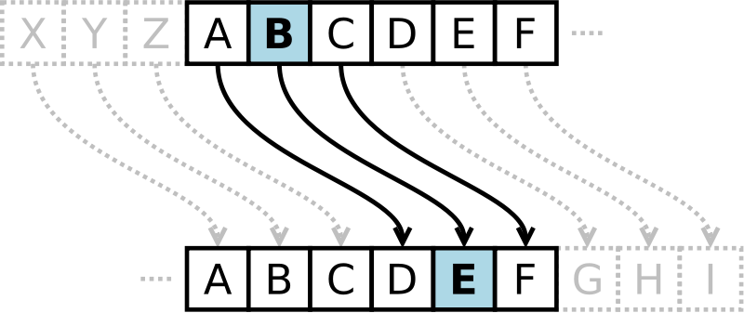
Caesar Cipher
Earliest documented cipher was used by Caesar in 50BC !
Each letter in a message is substituted by another that is 3 letters away
A becomes D, B becomes E, etc.
Note that the letters ”wrap around” at the end of the alphabet, which can be mathematically expressed using mod 26

Slide 25
Caesar Cipher Example
A | B | C | D | E | F | G | H | I | J | K | L | M | N | O | P | Q | R | S | T | U | V | W | X | Y | Z
0 | 1 | 2 | 3 | 4 | 5 | 6 | 7 | 8 | 9 | 10 | 11 | 12 | 13 | 14 | 15 | 16 | 17 | 18 | 19 | 20 | 21 | 22 | 23 | 24 | 25
ATTACK AT DAWN
DWWDFN DW GDZQ
Notes:
DWWDFN DW GDZQ

Slide 26
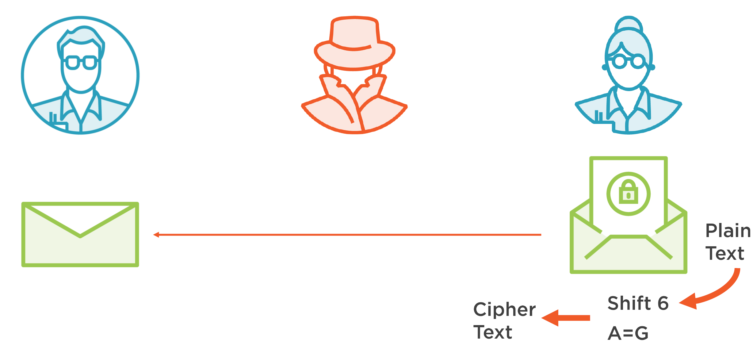
Shift Cipher
Generic version of Caesar cipher
Each letter is shifted by N. In Caesar, N=3
Let k, x, y ε {0,1, …, 25}
Encryption: y = e_{k}(x) ≡ x + k mod 26
Decryption: x = d_{k}(x) ≡ y - k mod 26

Slide 27
Shift Cipher: Example
A | B | C | D | E | F | G | H | I | J | K | L | M | N | O | P | Q | R | S | T | U | V | W | X | Y | Z
0 | 1 | 2 | 3 | 4 | 5 | 6 | 7 | 8 | 9 | 10 | 11 | 12 | 13 | 14 | 15 | 16 | 17 | 18 | 19 | 20 | 21 | 22 | 23 | 24 | 25
Let’s do one for N=10…
ATTACK AT DAWN
KDDKMU KD NKGX
Notes:
KDDKMU KD NKGX
Just wrap around

Slide 28
Shift Cipher Cryptanalysis
How do we break this?
Brute-force: Try all possible values for N
There are only 26
Feasibility?
Easy by hand
Trivial by computer

Slide 29
Substitution Cipher

Slide 30
Substitution Cipher
A | B | C | D | E | F | G | H | I | J | K | L | M | N | O | P | Q | R | S | T | U | V | W | X | Y | Z
Q | R | A | W | G | N | C | X | M | B | V | L | Z | D | S | J | T | E | K | Y | F | U | I | P | O | H
Generate a random set of substitutions for each letter
Always a 1:1 correspondence

Slide 31
Substitution Cipher Example
A | B | C | D | E | F | G | H | I | J | K | L | M | N | O | P | Q | R | S | T | U | V | W | X | Y | Z
Q | R | A | W | G | N | C | X | M | B | V | L | Z | D | S | J | T | E | K | Y | F | U | I | P | O | H
ATTACK AT DAWN
QYYQAV QY WQID
Notes:
QYYQAV QY WQID

Slide 32
Substitution Cipher Cryptanalysis
Brute-force: Try all possible letter combinations
There are (26!) = 403291461126605635584000000
Exhaustive key search will take a long time …
Letter frequency analysis attack can be used against the substitution cipher
Notes:
The secret is no more the offset
Given an arbitrary long cyphertext, the secret key requests the following number of guesses 26!

Slide 33
Substitution Cipher Cryptanalysis
QYYQAV QY WQID
Key observation: In a substitution cipher, basic language features are preserved
You can tell how often a letter occurs in the message
You can see when letters repeat
Etc.
Use a technique called frequency analysis

Slide 34
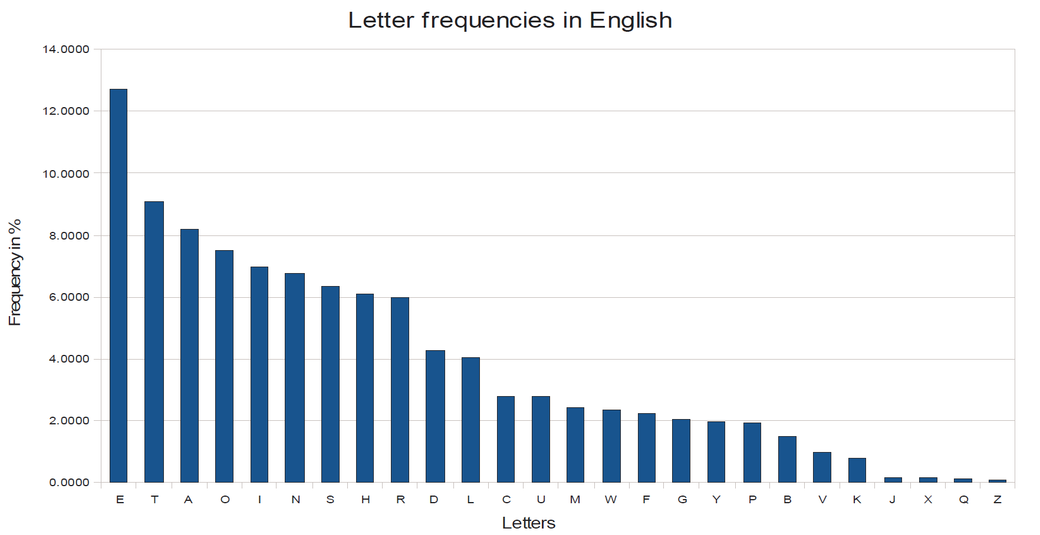
Frequency Analysis
Not all letters in a language occur with the same frequency. E.g., In English,
E is most common
Vowels are about 40%
Vowels tend to be separated by consonants
Q tends to be followed by U
Etc.
Notes:
http://pi.math.cornell.edu/~mec/2003-2004/cryptography/subs/frequencies.html
A cryptanalysis technique discovered by Al-Kindi in Iraq
In practice, not only frequencies of individual letters can be used for an attack, but also the frequency of letter pairs (i.e., “th“ is very common in English), letter triples, etc.

Slide 35
Breaking the Substitution Cipher with Letter Frequency Attack
Let‘s take an example and identify the most frequent letter:
iq ifcc vqqr fb rdq vfllcq na rdq cfjwhwz hr bnnb hcc hwwhbsqvqbre hwq vhlq
We replace the ciphertext letter q by E and obtain:
iE ifcc vEEr fb rdE vfllcE na rdE cfjwhwz hr bnnb hcc hwwhbsEvEbre hwE vhlE
By further guessing based on the frequency of the remaining letters we obtain the plaintext:
WE WILL MEET IN THE MIDDLE OF THE LIBRARY AT NOON ALL ARRANGEMENTS ARE MADE
In practice, not only frequencies of individual letters can be used for an attack, but also the frequency of letter pairs (i.e., “th“ is very common in English), letter triples, etc.
35

Slide 36
Vigenère Cipher
(1900-1950)
Poly-alphabetic cipher
One plaintext letter can become different ciphertext letters
Uses a text based key and modulo arithmetic to perform the encryption
Frequency analysis is possible, but much more difficult

Slide 37
Vigenère Cipher: Example
A | B | C | D | E | F | G | H | I | J | K | L | M | N | O | P | Q | R | S | T | U | V | W | X | Y | Z
0 | 1 | 2 | 3 | 4 | 5 | 6 | 7 | 8 | 9 | 10 | 11 | 12 | 13 | 14 | 15 | 16 | 17 | 18 | 19 | 20 | 21 | 22 | 23 | 24 | 25
Let’s choose a key of “MONKEY”
ATTACK AT DAWN
MONKEY MO NKEY
MHGKGI MH QKAL

Slide 38
One-Time Pad Cipher

Slide 39
One-Time Pad
Vigenère cipher with a randomly chosen key as long as the message
Key needs to be shared between parties beforehand
Key can never be re-used
Provable unbreakable without the key
This is the only perfect cryptography

Slide 40
One-Time Pad: Example
A | B | C | D | E | F | G | H | I | J | K | L | M | N | O | P | Q | R | S | T | U | V | W | X | Y | Z
0 | 1 | 2 | 3 | 4 | 5 | 6 | 7 | 8 | 9 | 10 | 11 | 12 | 13 | 14 | 15 | 16 | 17 | 18 | 19 | 20 | 21 | 22 | 23 | 24 | 25
A | B | C | D | E | F | G | H | I | J | K | L | M | N | O | P | Q | R | S | T | U | V | W | X | Y | Z
26 | 27 | 28 | 29 | 30 | 31 | 32 | 33 | 34 | 35 | 36 | 37 | 38 | 39 | 40 | 41 | 42 | 43 | 44 | 45 | 46 | 47 | 48 | 49 | 50 | 51
Our random key is “FOWIFOZMQOAF”
ATTACK AT DAWN
FOWIFO ZM QOAF
FHPIHY ZF TOWS

Slide 41
One-Time Pad
Perfect Secrecy is guaranteed by the One-time Pad
Unconditionally secure cryptosystem:
A cryptosystem is unconditionally secure if it cannot be broken even with infinite computational resources
THE GOOD: Unbreakable regardless of the power of the adversary
THE BAD: Impractical! Needs very, very long shared keys

Slide 42
Crypto Components
All of the previous techniques have two basic components:
Algorithm (What you do to the message)
Key (The secret that you need in order to encrypt/decrypt properly)
When using these algorithms, the key is secret
The algorithm is not

Slide 43
Summing Up
We trust a cryptographic algorithm if lots of smart people can’t break it
We looked at three types of simple ciphers:
Shift Cipher
Substitution Cipher
One-Time Pad Cipher
They each have an algorithm and a key
Long key is required for cryptographic algorithms in order to prevent exhaustive key-search attacks
Notes:
Cryptography is a type of mathematics dedicated to secret codes
Vigenère Cipher
64 bit: insecure except for data with extremely short-term value
128 bit: long-term security of several decades, unless quantum computers become available
256 bit: as above, but probably secure against attacks by quantum computers

Slide 44
Resources
Cryptool - Software demonstrating many ancient and modern ciphers
https://www.cryptool.org/en/
An excellent one-hour video summarizing the last 40 years of modern cryptography by Ron Rivest
The International Association of Cryptographic Research is the professional organization of cryptographers.

